Slide 1
Employee Data Analysis using Excel
STUDENT NAME: M.SANGEETHA
REGISTER NO: 312204834 / asunm217312204834
DEPARTMENT: COMMERCE
COLLEGE: THIRUMURUGAN ARTS AND SCIENCE
COLLEGE FOR WOMEN

Slide 2
PROJECT TITLE
Employee Performance Analysis using Excel

Slide 3


AGENDA
Problem Statement
Project Overview
End Users
Our Solution and Proposition
Dataset Description
Modelling Approach
Results and Discussion
Conclusion
3/21/2024 Annual Review

Slide 4

PROBLEM STATEMENT * Employee performance is analyzed to known the performance level if the employees to give Bonus and to increase their increments.

Slide 5

PROJECT OVERVIEW * The project Employee performance analysis is the performance level of the employees are analyzed to make a pivot table and to convert the pivot table to a Bar chart to identify which team has performed well.
.

Slide 6

WHO ARE THE END USERS?
* Employees
* Employer
* Manager
* Human Resource (HR)
* Customers
* Client
* Team Leaders
* Organizations
WHO ARE THE END USERS?
* Employees
* Manager's
* Team Leaders
* Human Resource (HR)
*

Slide 7

OUR SOLUTION AND ITS VALUE PROPOSITION Conditional Formatting - Missing Data on Exit Date Formula - IFS(Z8>="VERY HIGH", Z8>="HIGH",Z8>="MED"TRUE "LOW") Pivot Table - Graph Bar Chart - Final Output

Slide 8
Dataset Description Employee Data - Kaggle 26 Features 9 Features Empl ID - Numeric First Name Last Name Performance Level Business Gender Code

Slide 9

THE "WOW" IN OUR SOLUTION VERY HIGH, HIGH, MED, LOW - Fairly evenly distributed The total countsbof VERY HIGH are relatively low compared to Other categories.
3/21/2024 Annual Review
9

Slide 10
GenderCode (All) Count of FirstName Column Labels Row Labels HIGH LOW MED VERY HIGH Grand Total BPC 16 34 85 15 150 CCDR 18 47 65 15 145 EW 21 41 78 14 154 MSC 17 39 92 9 157 NEL 21 41 77 15 154 PL 29 33 69 12 143 PYZ 26 41 75 15 157 SVG 26 43 82 16 167 TNS 21 45 71 13 150 WBL 25 34 84 13 156 Grand Total 220 398 778 137 1533
MODELLING
Data Collection
Naan Mudhalvan Portal
Feature Collection
1) Categorial features - Gender code
2) Numerical features - Performance level
Data Cleaning
Conditional formatting
Performance level
1)VERY HIGH
2) HIGH
3) MED
4) LOW
10

Slide 11
MODELLING Summary Pivot Table Visualization Bar Chart
11

Slide 12
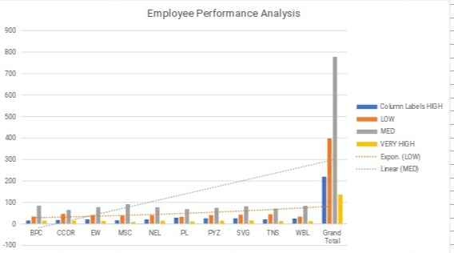
RESULT

Slide 13
CONCLUSION
The Conclusion of the Project
Is that the MSC team of employees having the Very High Performance level.

